Slide 1


Presented by Group 2-supervised by: Dr.Hanan Altamimi
IT326-Global video games sales

Slide 2
Outline
01.
02.
03.
Data graphs
Problem
Data
04.
05.
06.
07.
Data pre-proccessing
Classification
Clustering
Findings

Slide 3

Problem:
We live in a time when video games are extremely popular. The global video game market continues to grow year-on-year, and the industry is now valued at over $100 billion worldwide.
Using data mining techniques we can predict the popularity of upcoming games

Slide 4

Data
Our data consists of:
16598 observation
11 attibute which are:
Rank
Name
Platform
Year
Genre
Publisher
NA_Sales
EU_Sales
JP_Sales
Other_Sales
Global_Sales
Source:
Kaggle,https://www.kaggle.com/datasets/gregorut/videogamesales

Slide 5

Data graphs

Slide 6
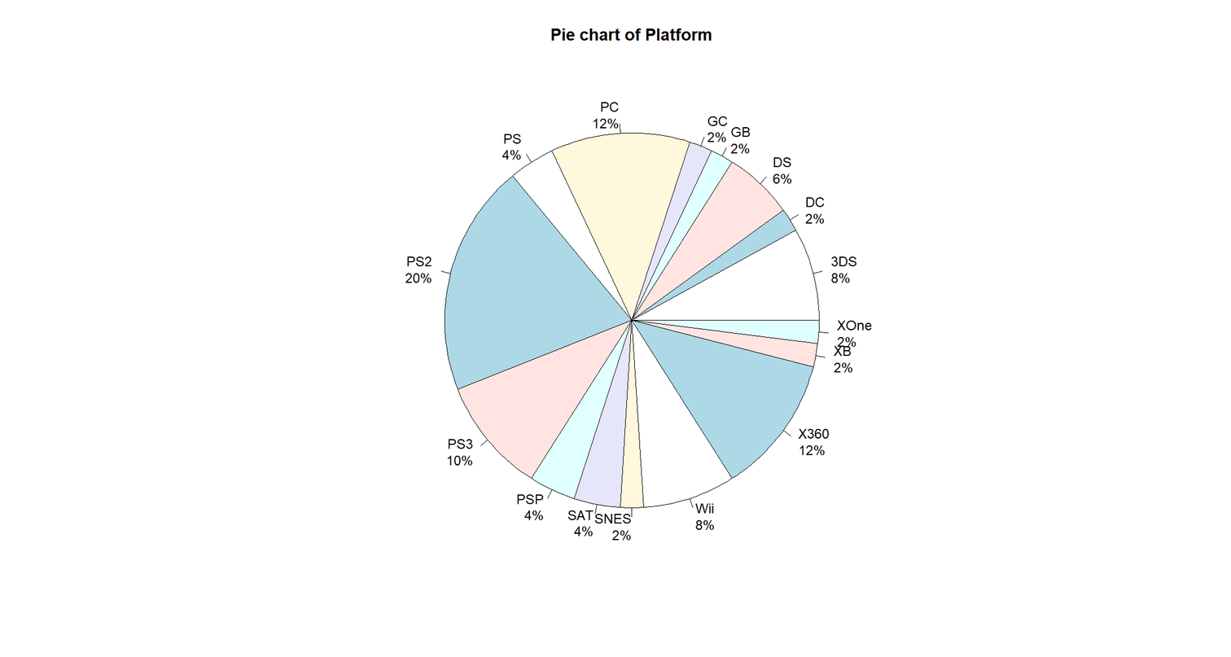
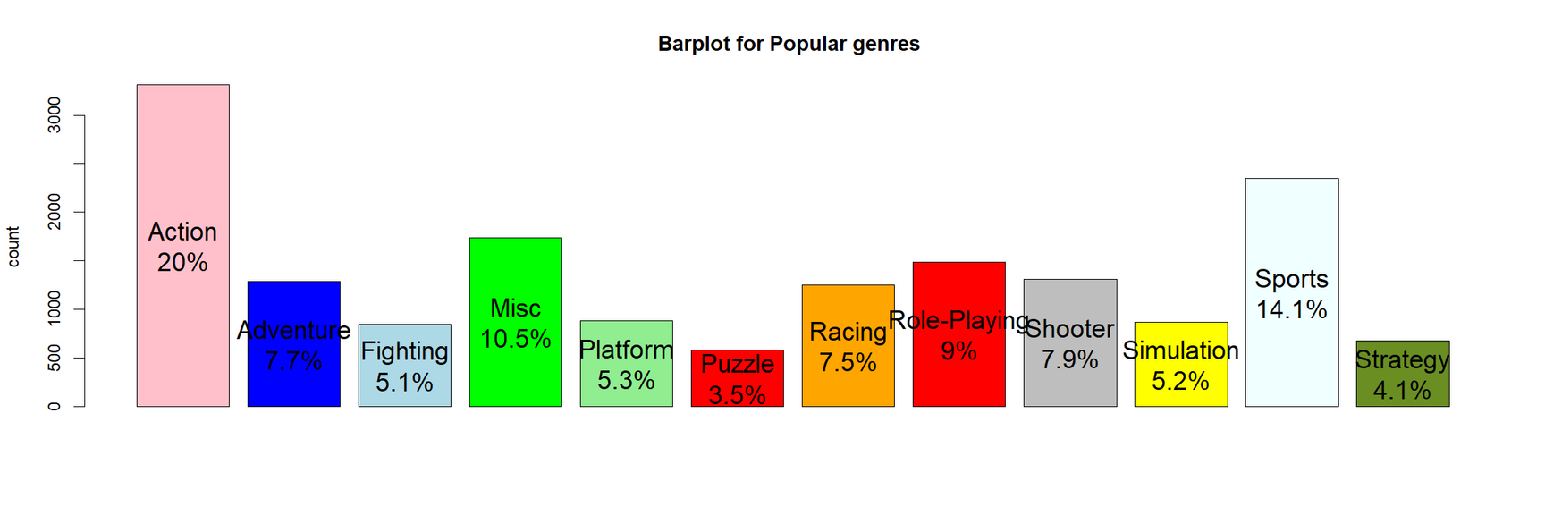
Data graphs
Pie chart:
Bar plot:

Slide 7
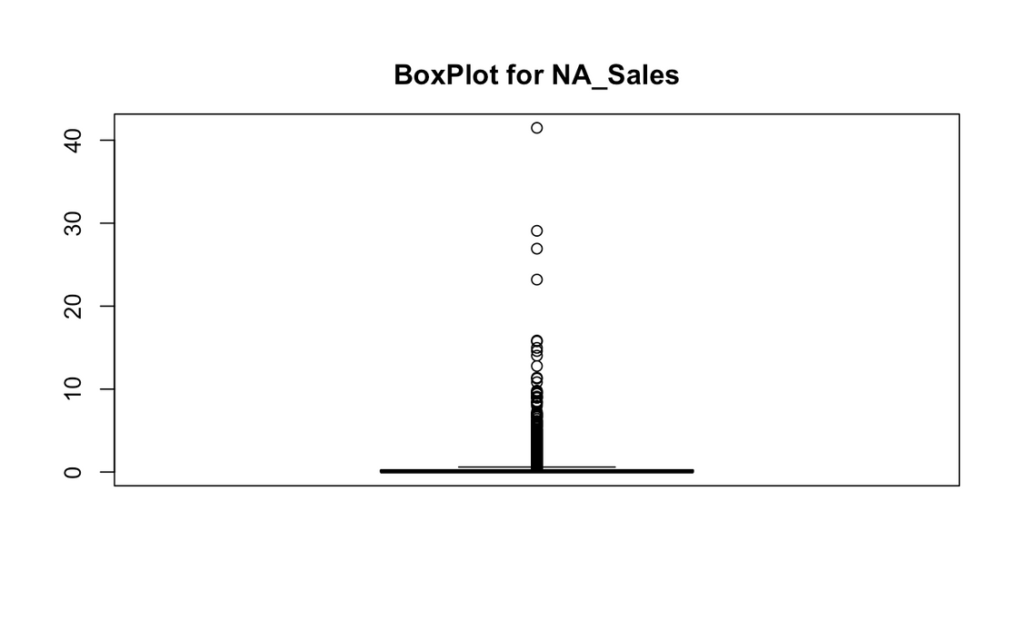
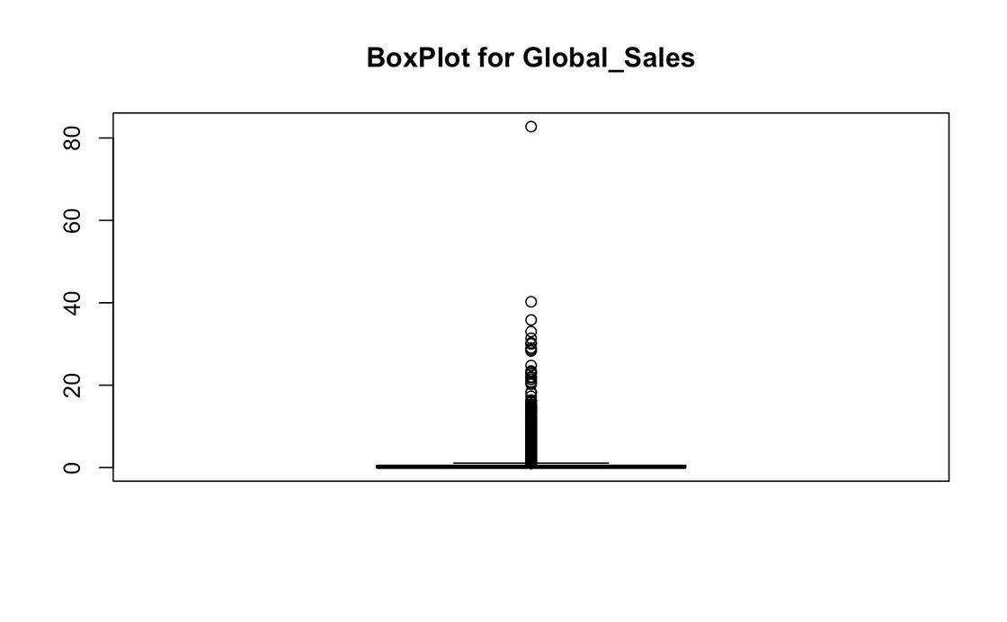
Data graphs
Boxplot:

Slide 8
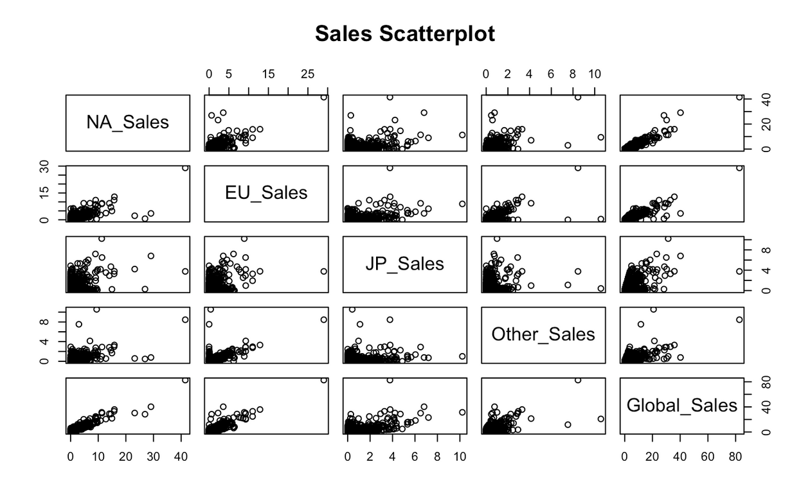
Data graphs
Scatterplot:

Slide 9


Data Preprocessing
We applied several preprocessing techniques to improve the accuracy and efficency of the data.
Data cleaning
Data transformation
Feature
selection

Slide 10


Data Cleaning
We checked if our dataset cointans any missing or null values ,and replaced the missing values with global constants.
We checked if our dataset contains any outlier attributes , and deleted them.

Slide 11
Data Transformation:
Normalization
We chose min-max normalization because it transforms the data into a specific range,(0-1), which enhances its suitability for visualization and comparison.
We normalized and scaled the sales attributes , to take values between 0 and 1.

Slide 12
Discritization:
We needed discertization for our continuous-valued attributes, because we need it for classification, we discretized using -arules- library.
We ended up with three ranges for each continous-value, we labeled them:low-medium-high, so we can perform c5.0 algorithm-it doesn’t work for ranges-
.

Slide 13


Balancing:
We used groupdata2 to balance our dataset to ensure that each class has a similar representation,
which can improve the performance and fairness of the machine learning model.
technique used is Downsampling
Since our dataset has a large num of observation, it will helps to reduce the number of instances in the majority class to match the number of instances in the minority class.

Slide 14

Feature selection
We assess the significance of each feature for predicting Global Sales by calculating ROC curve scores and rank them.
Remove the least impactful feature, JP_Sales, based on its low importance score to improve the model's focus on more influential features..

Slide 15
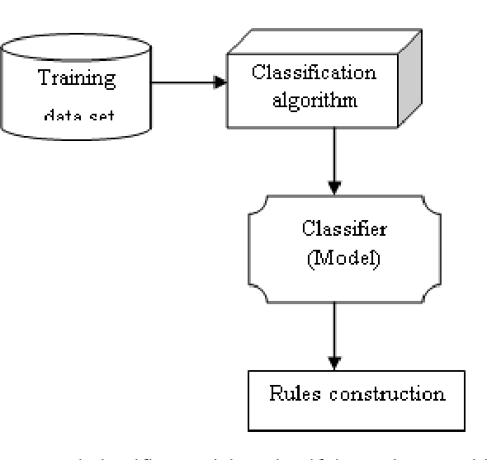
Classification
Goal:The goal of classification is to build a model or algorithm that can generalize patterns and relationships observed in the training data to make accurate predictions
We trained our model and to predict the populariy-low, medium, high- based on our class label(Global_Sales)

Slide 16
Splitting criteria:
With percentage-based splitting, we separated our dataset into Training and Test sets. This method ensures that each subset is randomly selected.
There are three different splitting proportions:
90% training set
10% testing set
80% training set
20% testing set
70% training set
30% testing set

Slide 17
Evaluation and comparison
90% training set 10% testing set
80% training set 20% testing set
70% training set 30% testing set
IG
IG ratio
Gini index
IG
IG ratio
Gini index
IG
IG ratio
Gini index
Accuracy
73.1
73.3
73.4
72.9
73.5
73.3
72.6
73.1
73.9
Precision
42.3
42.4
42.9
42.5
42.7
42.3
42.3
42.7
42.8
73.2
Sensitivity
73.3
73.3
73.4
73.5
88.0
73.5
73.3
52.9
86.5
86.5
86.6
86.6
86.7
42.4
86.7
86.6
50.0
Specificity

Slide 18
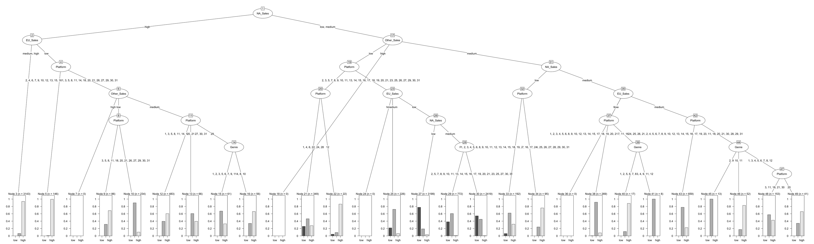
Best tree:IG ratio(80% train,20%test)

Slide 19
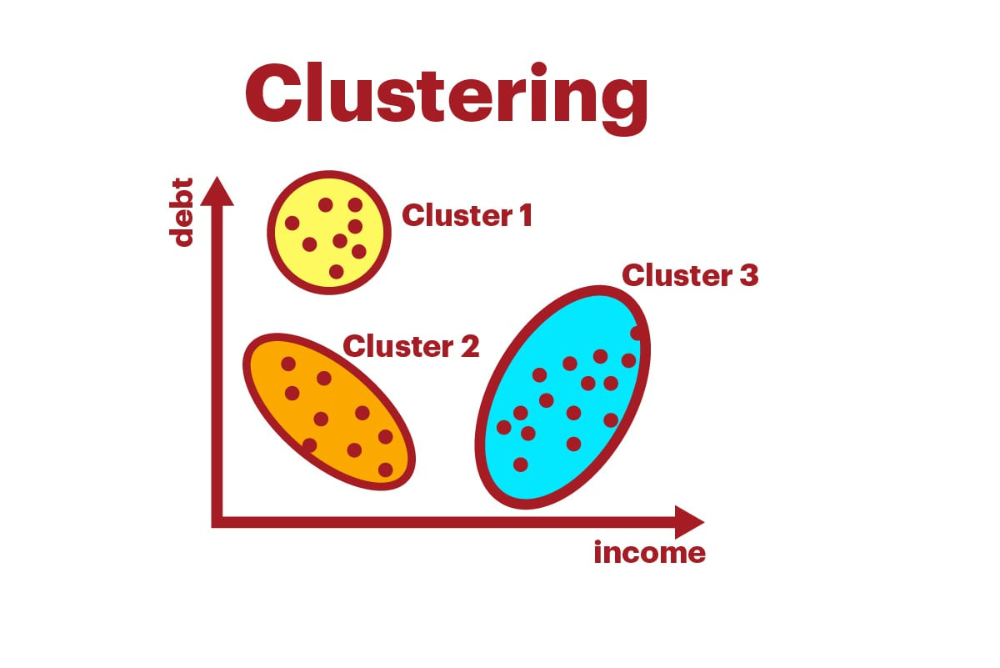
Clustering:
Clustering is a method that groups data points based on their similarities, aiming to uncover patterns, structures, or relationships within a dataset without prior knowledge of existing groups or classes.

Slide 20
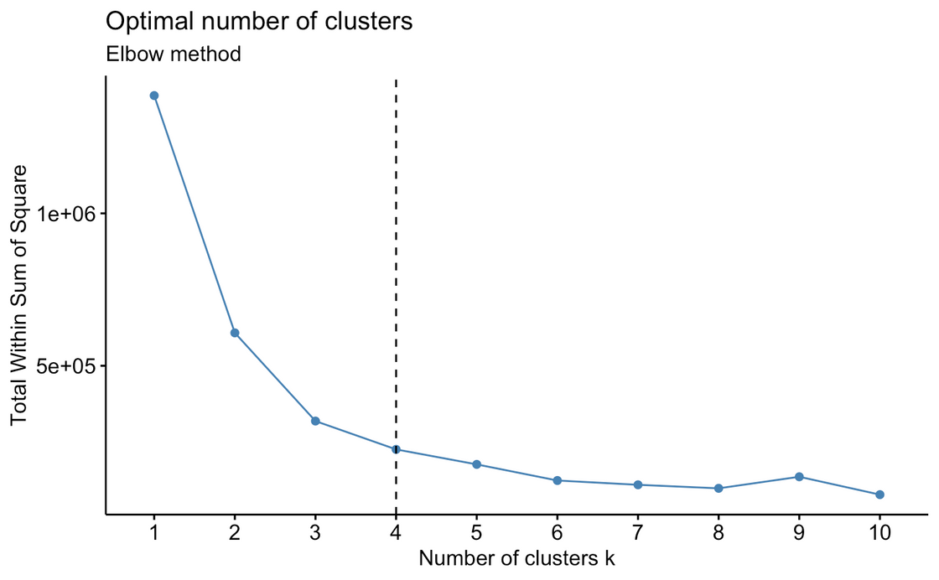
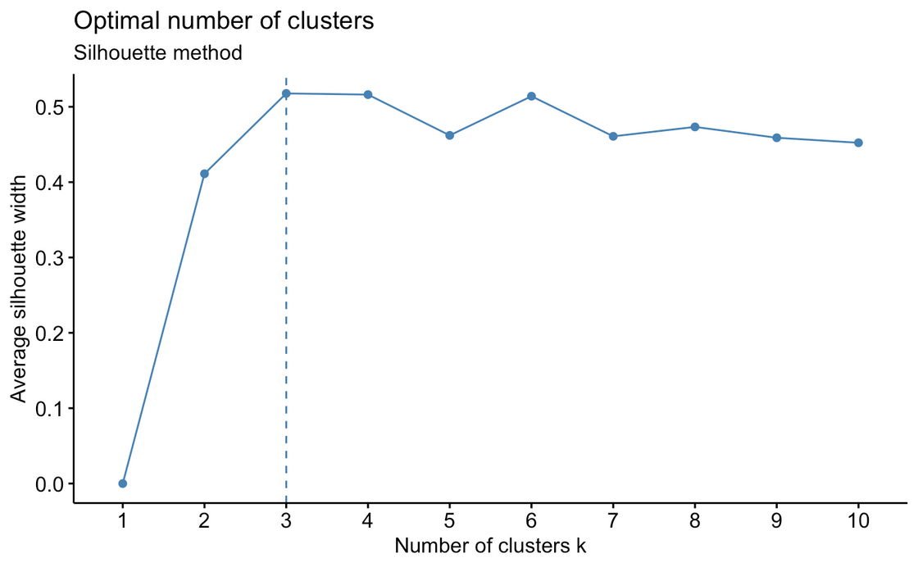
Choosen optimal number of clusters
1-Elbow method
2- Average silhouette width

Slide 21
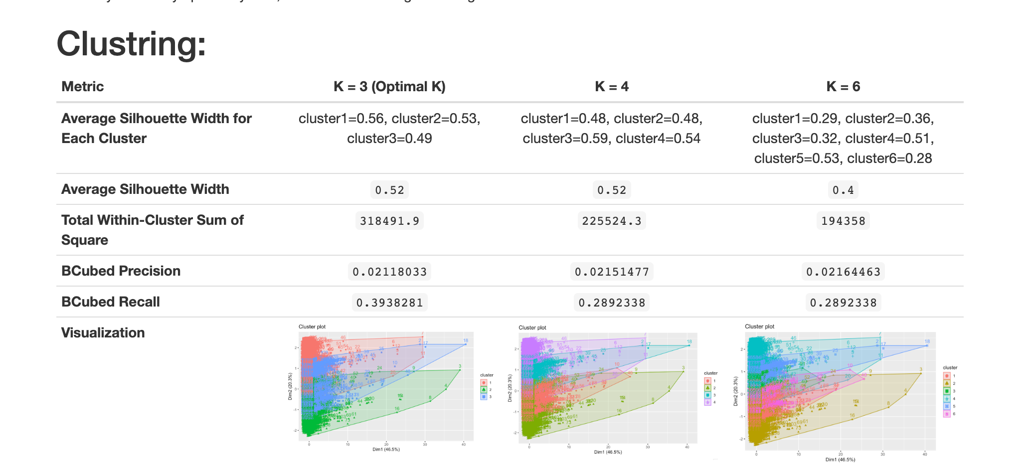
Evaluation and comparison

Slide 22

Findings
we found that classification is better suited for our main goal which is predicting the popularity of games.
On the other side, clustering, while having its benefits, faced challenges in defining popularity levels because of the overlap and ambiguity among clusters make it unfit for predicting a game’s popularity.

Slide 23
References
https://methodenlehre.github.io/SGSCLM-R-course/index.html
https://youtu.be/kkhdpB4dNg0?si=OQodRxZckv40DIUs
https://youtu.be/yVBj-D7zjgY?si=AARc78sUJWohKHYT
https://www.onlinemathlearning.com/scatter-plots.html
https://www.statology.org/how-to-normalize-data-in-r/
https://jtr13.github.io/cc21fall2/feature-selection-in-r.html
https://www.rdocumentation.org/packages/arules/versions/1.7-6/topics/discretize
https://afit-r.github.io/kmeans_clustering
https://www.datanovia.com/en/lessons/determining-the-optimal-number-of-clusters-3-must-know-methods/
https://towardsdatascience.com/clustering-analysis-in-r-using-k-means-73eca4fb7967
https://www.r-bloggers.com/2021/04/cluster-analysis-in-r/
https://rpubs.com/camguild/803096
https://rpubs.com/kjmazidi/195428
https://rpubs.com/njvijay/148
https://www.rdocumentation.org/packages/groupdata2/versions/1.1.2

Slide 24
Thank you for listening!
Group members:
Aljawhara Mansour Aldhayan - 443200433
Duna Alabdulaziz -443200258
Lama Alenzi - 443200881
Ghala Alotaibi- 443200504

